Slide 1
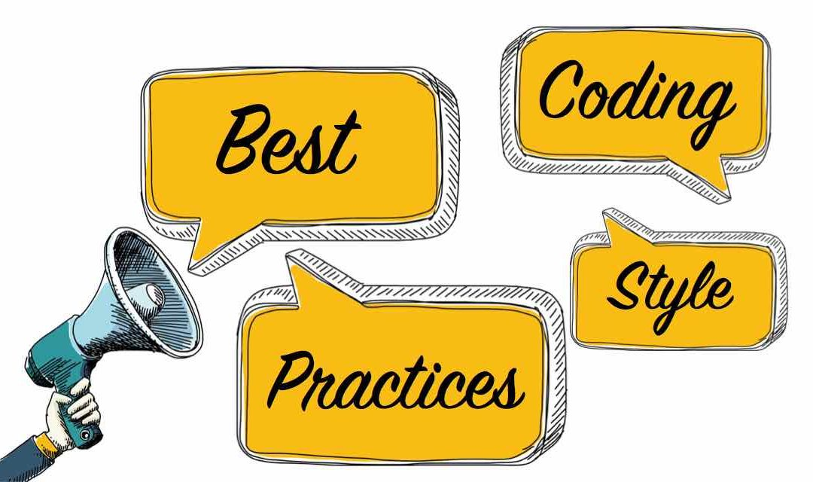
Coding best practices
The idea of this presentation is to make the any application /project code simpler/clean/easy/optimized/efficient/readable/enhanceable.
By-Dinkar Maurya

Slide 2
Agenda
Standard and optimized coding practises.
Best practise is shown with different examples.
Advantages-
Code maintenance reduced by ~ 30-40% in terms of cost
Bug is reduced by ~20-30%
Efficiency/readability of code is improved.
Code review cost is reduced.
LOC of entire application code is reduced.

Slide 3
Standard and optimized coding practises
Below are some of the basic points which keeps project very clean/easy/optimized/efficient/readable/enhanceable
Why optimisation.
Don’t keep even single unused variables/methods/packages/resources etc.
Follow naming convention very strictly.
Differentiate between global and local variables.
Specify the scope of variable/ method/ class/package before defining and using, its most important.
Avoid duplicate calculation of values.
Never define repetitive methods instead reuse existing method if any, also follow method overloading concepts.
Always use ternary operator as much as possible instead of if else.
Why switch over if else
Use of if else chaining statement.
Prefer empty items to null ones.
Prefer writing generic codes. Use latest APIs always.
Focus on exception handling.
Use of design patterns as much as possible. Example shown via coupling and cohesion.
After the end of slide one should be able to understand above points.

Slide 4
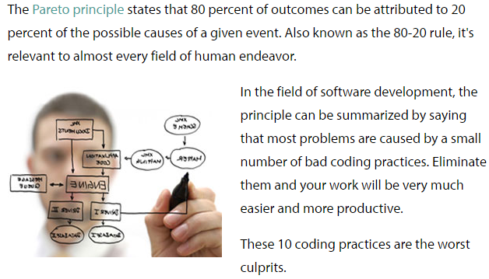
Why optimization?
Optimization can reduce readability and add code that is used only to improve the performance.
This may complicate programs or systems, making them harder to maintain and debug.
Ease of creation
Ease of maintenance
Ease of enhancement
Writing optimized code does not enforces us to write tricky code.
Trickier your code, the harder to write, debug, and maintain.
The Pareto principle (also known as the 80/20 rule, the law of the vital few, or the principle of factor sparsity)states that, for many events, roughly 80% of the effects come from 20% of the causes

Slide 5
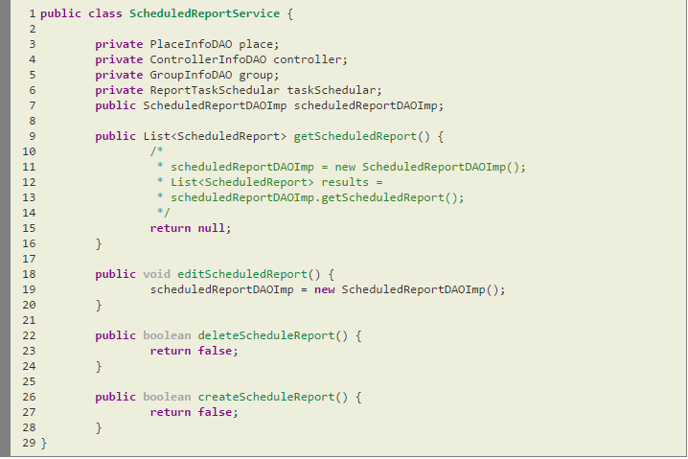
Basics
This is a sample class already developed by another developer, hey! Lets have a look on this
What are the improvement areas on this class?

Slide 6
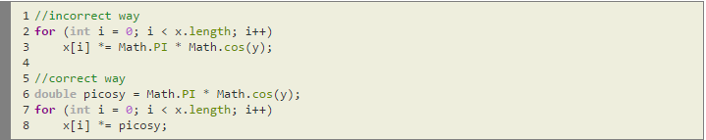
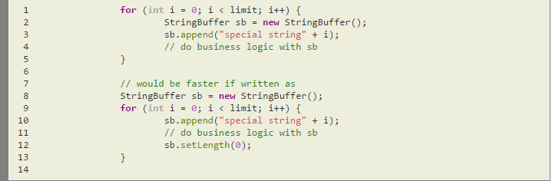
Repetitive calculations
Avoid repetitive calculations-
Calculation of Math.PI and Math.cos(y) has been done only once.
Repetitive declaration of string buffer-

Slide 7
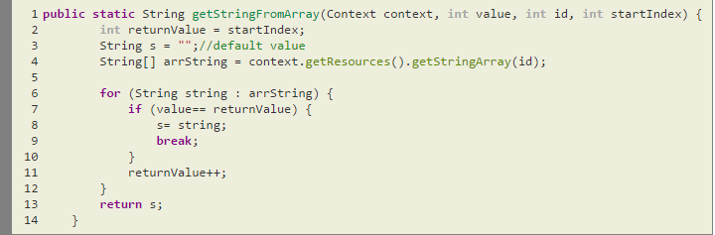
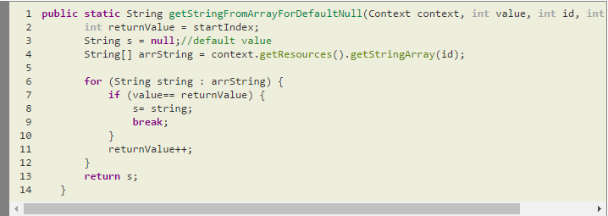
Overloading – not writing repetitive code
If a class has multiple methods having same name
but different in parameters, it is known
as Method Overloading.
Following is an existing method which
I need to enhance.
As a new developer I want to use getStringFromArray()
method functionality but default value not as ““ empty.
I want my default value null.
So what I do is copy and paste above method and
replace ""->null inside new method
“getStringFromArrayForDefaultNull()”
Am I correct in above case?
Copy and paste whole code and completed my requirement in zero minute? Was this useful for next developer to modify/add any new functionality related to this method? If he tries to do something he has to look tow same kind of methods!

Slide 8
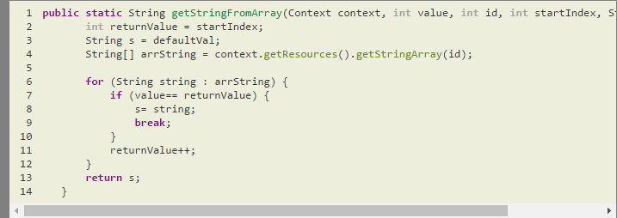
Overloading – not writing repetitive code
Correct way - override the existing method.
Existing method calling remain same, no need to change it.
Updated the existing method with argument
defaultVal.
Now getStringFromArrayForDefaultNull() instead of
doing this call reusable method getStringFromArray()
with the argument you want.
This save lots of effort in terms of debugging, maintenance, reduce test cases for new method.
So at the end of the day as a new developer I have to look only single method.

Slide 9
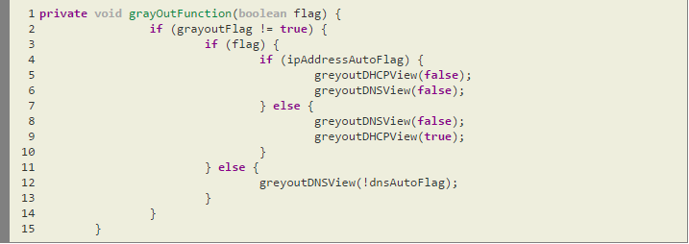
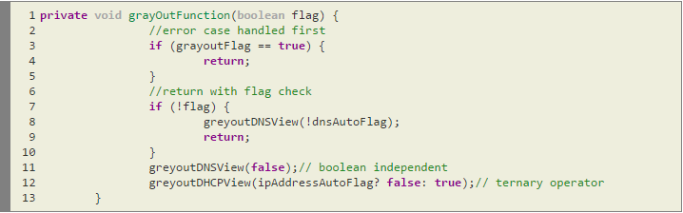
Use of ternary operator
Bad coding style – conditional check is very much confusing and developer have too look very carefully while debugging
After optimization – it seems very easy to understand
Check boundary condition first and return
Check flag condition and return, removed repetitive line of code.
Greyout dns view always takes false argument so write it once

Slide 10
Why switch over if else
Switch can be used only for a specific value and can not be used for range of values or for conditions involving multiple variables.
For switch the values should be 1 or 2 or 3 etc.
When we use if we could use conditions like greater than 1 and less than 15 etc.
Hence we have specific value as condition then we should use switch instead of if else. Reason is explained below-
Why switch is faster than if else
Because there are special bytecodes that allow efficient switch statement evaluation when there are a lot of cases.
If implemented with IF-statements you would have a check, a jump to the next clause, a check, a jump to the next clause and so on(Lookupswitch).
With switch the JVM loads the value to compare and iterates through the value table to find a match, which is faster in most cases(Tableswitch).
Lookupswitch vs Tableswitch
The difference is that a lookupswitch uses a table with keys and labels, yet a tableswitch uses a table with labels only.
When performing a tableswitch, the int value on top of stack is directly used as an index into the table to grab the jump destination and perform the jump immediately. The whole lookup+jump process is an O(1) operation, that means it's blazing fast.
While in lookupswitch it might take o(n) or more time.
Tableswitch is usually more efficient.

Slide 11
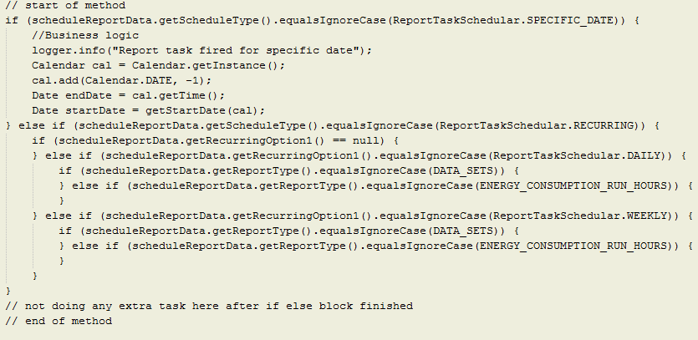
Use of if else
Bad practise example – writing tightly connected if else statement unless until required.
In below example if else can be simplified. After simplification it would be easier to debug/read/enhance.

Slide 12
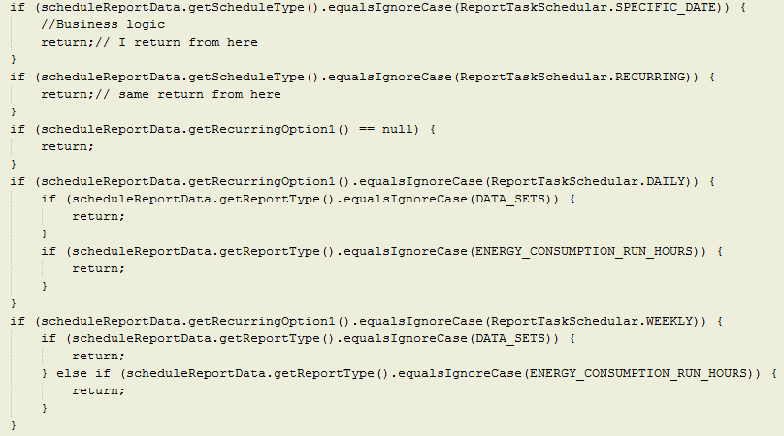
Use of if else - Optimization first level
Break if else chaining and write return from the block, since at the end of method no business logic is written.
Makes code little bit easier understand/debug/enhance.
This reduce the maintenance cost.

Slide 13
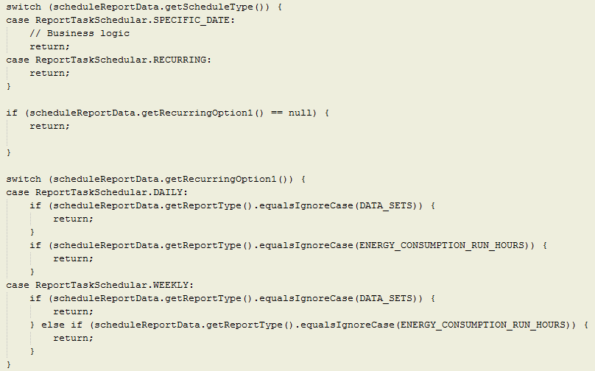
Use of if else - Optimization second level
Use switch instead of if else
Switch is faster than if else in terms of execution.
Clean coding easy to understand and debug.

Slide 14
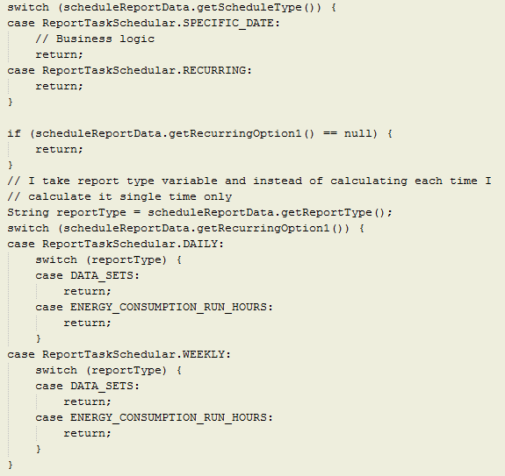
Use of if else - Optimization third level
Remove repetitive calculation, report type has been calculated single time.
Replace inner if else with switch case, again switch is faster than if else.

Slide 15
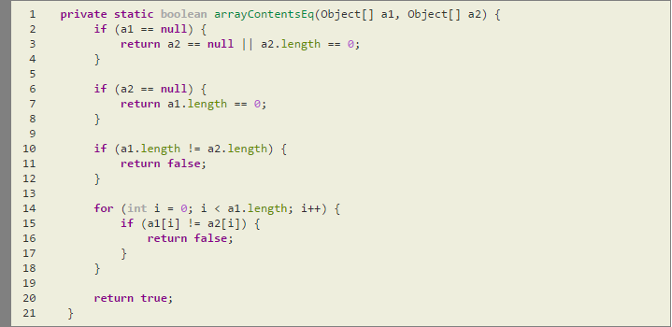
Use of if else Demo
Below is the example taken from jdk to show how efficiently if else has been used.
Can we also try writing this style of coding standard.
Class.class , Jdk1.8, rt.jar
Line number 3089 -
The best uses of if return – clean coding style

Slide 16
Prefer empty items to null ones
There are many cases in which an "empty" object can be used instead of a null object reference. This is usually preferable, since it helps eliminate one of the most common problems encountered during development: the NullPointerException.
The following qualify as "empty" objects:
The empty String
zero-length arrays
collections containing 0 items
maps containing 0 items
Example declarations of empty items:
String item = "";
BigDecimal[] items = new BigDecimal[0];
List<Integer> items = new ArrayList<>();
Map<String, Integer> items = new LinkedHashMap<>();

Slide 17
Prefer writing generic codes. Use latest APIs always.
Below is the example show, after optimization generic reusable practise has been shown.
Showing use of deprecated APIs,
if else uses is chaining unnecessarily,
Repeated function calls for date.
private Date getStartDate(Calendar cal) {
if (scheduleReportData.getReportStartDate() != null) {
logger.debug("Has Start Date " + scheduleReportData.getReportStartDate() + " Date object "
+ new Date(scheduleReportData.getReportStartDate()));
return new Date(scheduleReportData.getReportStartDate());
} else {
logger.debug("N - today");
return cal.getTime();
}}

Slide 18
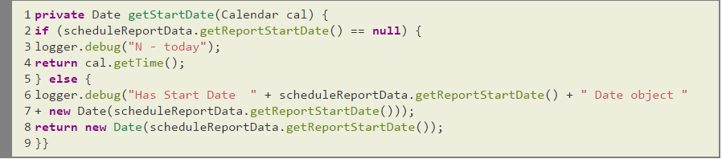
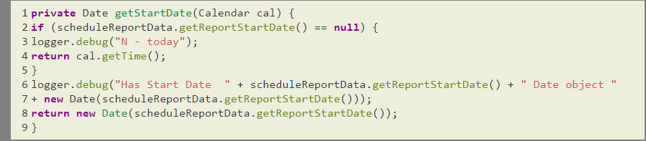
Optimization first & second level
Check error condition first, I move == null case first and return from function call.
Since after null check return statement is written, now else block is not required.
So I removed else block.

Slide 19
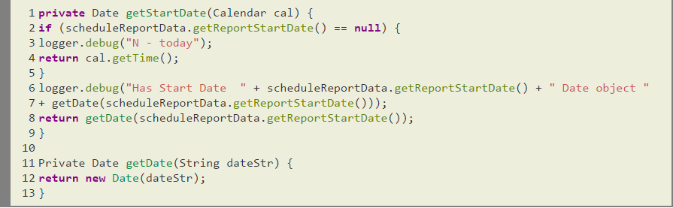
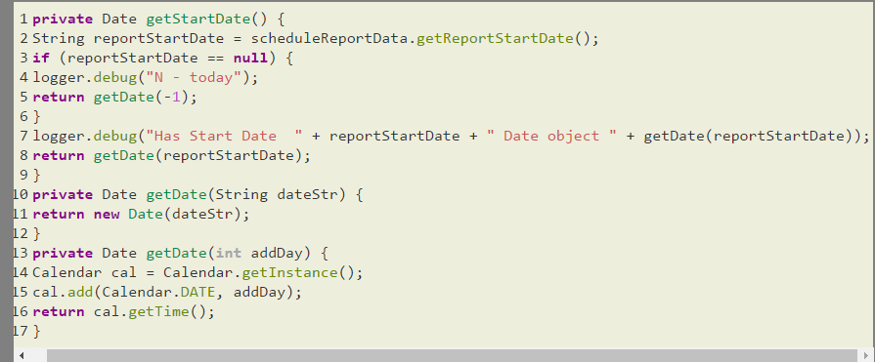
Optimization third & fourth level
I create getDate() method instead of writing two times new Date
Remove parameter calendar from main method.
Create a reusable method which takes -1 as argument.

Slide 20
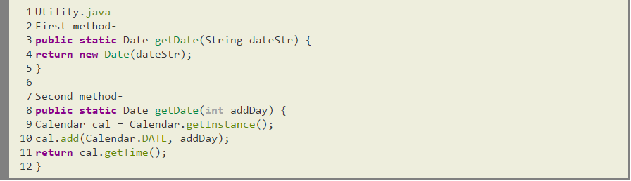
Optimization fifth level
What if I define below method in any Utility.java file and reuse in above code?
This will make another developer to reuse this existing methods not writing again and again same method.
Finally at the end of day I have reusable and generic code.

Slide 21
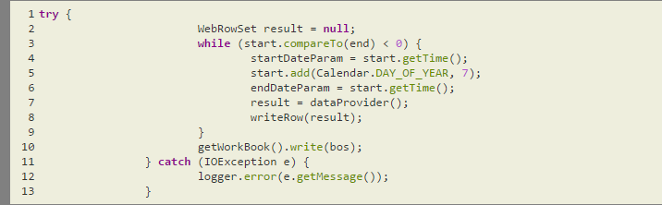
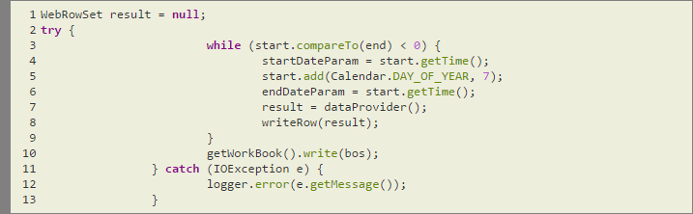

Exceptions
Don’t put code inside try block which will never throw exception.
All the try {} statement adds to your code as far as overhead is the goto bytecode to skip the catch () {} statement and one or more entries in the method's exception table. (An exception table keeps track of the beginning and ending bytecode offsets for try statements and the offsets of the corresponding catch and finally statements.) A finally statement adds a little more overhead as it is implemented as an inline subroutine.
If you're simply going to catch and handle the exception, then repeatedly instantiating an exception can be a waste of time. Instead, it is possible to reuse an exception:
Take care of handling exception handling – if parent exception is handled no need to handle child exception, try to catch specific exception rather than handling Exception parent class.

Slide 22
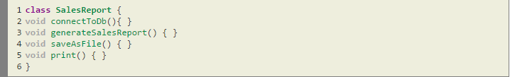
Cohesion
The purpose of showing cohesion is avoid writing all code in single class file.
Coupling vs Cohesion - While coupling has to do with how classes interact with each other, cohesion is all about how a single class is designed.
The term cohesion is used to indicate the degree to which a class has a single, well-focused purpose.
The more focused a class is, the higher its cohesiveness. The key benefit of high cohesion is that such classes are typically much easier to maintain (and less frequently changed) than classes with low cohesion.
Another benefit of high cohesion is that classes with a well-focused purpose tend to be more reusable than other classes. Let’s take a look at a pseudocode example:
Now imagine your manager comes along and says, “Hey you know that accounting application we’re working on?
The clients just decided that they’re also going to want to generate a revenue projection report, oh and they want to do some inventory reporting also.
They do like our reporting features however, so make sure that all of these reports will let them choose a database, choose a printer, and save generated reports to data files...”

Slide 23
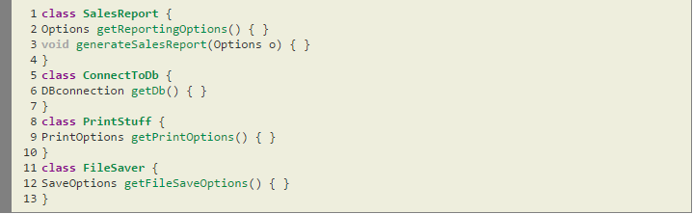
Cohesion – Tight cohesion is recommended
Rather than putting all the printing code into one report class, we probably would have been better off with the following design right from the start:
This design is much more cohesive.
Instead of one class that does everything, we’ve broken the system into four main classes, each with a very specific, or cohesive, role.
Because we’ve built these specialized, reusable classes,
it’ll be much easier to write a new report, since we’ve already got the database connection class,
the printing class, and the file saver class, and that means they can be reused by other classes that might want to print a report.
Again, as in Coupling, you may not get too many questions about cohesion but if you are (un)lucky you may get one or two…

Slide 24
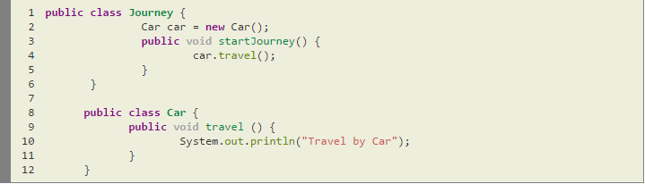
Coupling - Tightly coupled
Tightly coupled object is an object that needs to know quite a bit about other objects and are usually highly dependent on each other's interfaces.
Changing one object in a tightly coupled application often requires changes to a number of other objects.
In a small application we can easily identify the changes and there is less chance to miss anything.
But in large applications these inter-dependencies are not always known by every programmer and there is chance of overlooking changes.
In the above code the Journey class is dependents on Car class to provide service to the end user(main class to call this Journey class).
In the above case Journey class is tightly coupled with Car class it means if any change in the Car class requires Journey class to change. For example if Car class travel() method change to journey() method then you have to change the startJourney() method will call journey() method instead of calling travel() method.

Slide 25
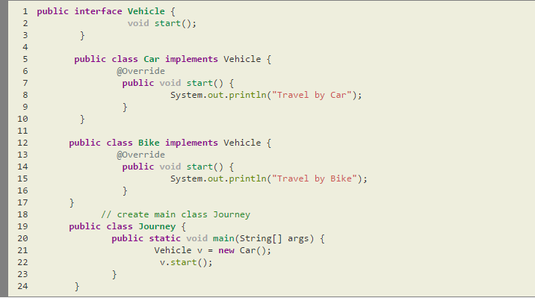
Coupling - Loose coupling is recommended
Loose coupling is a design goal that seeks to reduce the inter-dependencies between components of a system with the goal of reducing the risk that changes in one component will require changes in any other component.
Loose coupling is much more generic concept intended to increase the flexibility of system, make it more maintainable and makes the entire framework more stable.
Below code is an example of loose coupling,
In the above example, Journey and Car objects are loosely coupled. It means Vehicle is an interface and we can inject any of the implemented classes at run time and we can provide service to the end user.

Slide 26

Thanks

